Slide 1
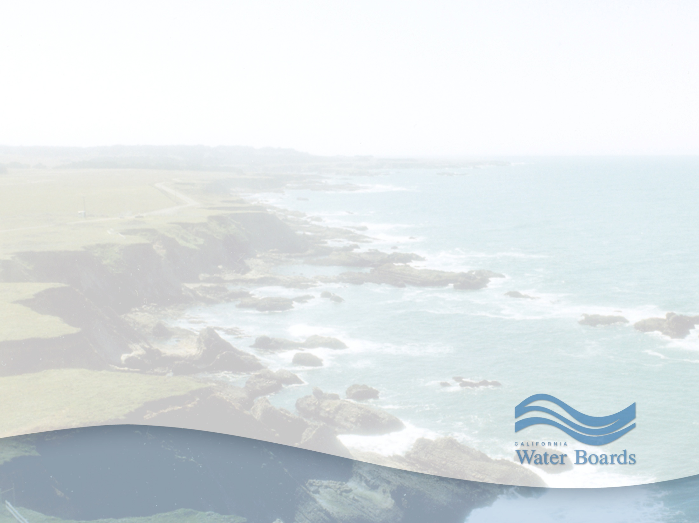
North Coast Regional Board 2017 Priority Projects
Item No. 8
March 8, 2017
Matt St. John

Slide 2
Purpose
Overview of 2017 Work Plan with focus on planned priority projects
Board member and public input on priorities for 2017 and beyond
2

Slide 3
Presentation Outline
Organizational structure
Staff funding
Programmatic work commitments
Priorities for 2017
3

Slide 4
Organizational Structure
83.8 authorized positions, plus 5 contract employees
6 vacancies
3 Divisions
9 Technical Units
1 Administrative Unit
5 Specialists
4

Slide 5
Positions & Funding
5

Slide 6
Point Source and Groundwater Programs
Program implementation:
Wastewater; Recycled Water; Storm Water; Solid Waste; Groundwater Site Cleanup
22 wastewater & solid waste permits;
16 planned for Board consideration in 2017
Priorities include:
Fortuna wastewater treatment plant (WWTP)
McKinleyville WWTP
Roseburg Forest Products WDR
6

Slide 7
Nonpoint Source Programs
Program implementation:
Timber; US Forest Service; County Roads; Agricultural Lands; Dairy; Cannabis; 401 dredge and fill
Permits under development:
Green Diamond Resource Company South Fork Elk Management Plan
Dairy Program general Order
Vineyard and Orchards general Order
Advising State Board on general Cannabis Order
7

Slide 8
TMDL Implementation
Various throughout Region
Particular focus in 2017:
Shasta and Scott River TMDL Waivers
Klamath River Basin
Elk River
8

Slide 9
2017 Planning Projects
Russian River Pathogens TMDL
Laguna de Santa Rosa Water Quality Credit Trading Program
9

Slide 10
Status of 2015 Triennial Review Priority Projects
Update Chemical Constituents objective and add groundwater toxicity objective – done
Update DO objective – done
Editorial amendments to Ch 3 & 6 – done
Russian River Pathogens TMDL - planned for 2017
Ocean beaches bacteria TMDLs - in development
Laguna de Santa Rosa TMDLs - in development
Seasonal discharge exemption criteria – in development
10

Slide 11
Status of 2015 Triennial Review Priority Projects
Flow objectives for Navarro River - in development
Outstanding National Resource Waters designation(s) - in process
Groundwater Protection Policy - in development
Policy to address the effects of climate change - in process
11

Slide 12
Other priority work
Flow studies in South Fork Eel, Shasta River, Mark West Creek
303(d) List and Integrated Report update
Monitoring efforts
Funding for small disadvantaged communities
Enforcement cases
12

Slide 13
Questions and Comments
13

